Slide 1
March 16th Sprint Presentation
Capstone Defence

Slide 2
User Stories for Sprint 5
As a gamer, I want to be shown that I’m logged into the website.
As a gamer, I want to be able to view my score on the leaderboard after it’s achieved.
As a gamer, I want to be able to play in different worlds.
As a gamer, I want to save my place in the game.
As a gamer, I want to be able to load my progress in the game when I return to it.
As a gamer, I want to be immersed in the game with various sounds.
As a gamer, I want to be able to play the game with lots of towers to use.
As a gamer, I want to be challenged while playing the game.

Slide 3
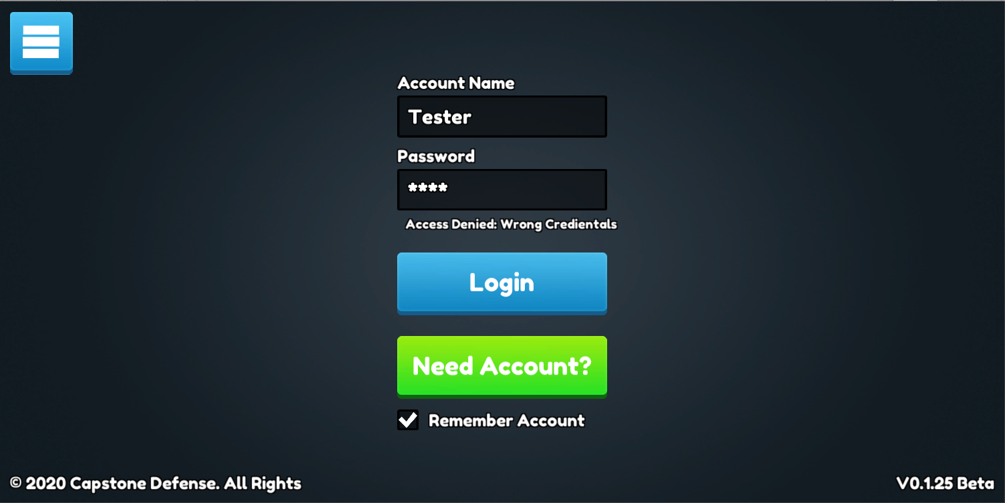
User Login
The login scene was created
The login scene is connected to our API and is exchanging information with backend
All buttons work; however, we are still in process of making “need account?” scene
Notes:
Mostly worked on user login this sprint…-jag

Slide 4
Leaderboard Functionality
Everything is ready in backend server side; however, we have not figured out how scores will be sent unity side
The API is set to handle all post requests for scores via registered users
Connectivity to unity is still in progress, but will be completed

Slide 5
Code Cleanup
Cleaned up some older scripts
Cleaner code makes it easier for me to make important changes for upcoming sprints
Changed a few things around to implement with next sprint

Slide 6
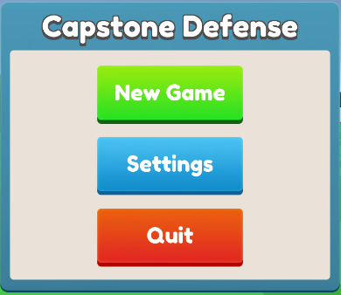
Updated Landing Screen
Customized new assets
Music added
New Game still works
Quit button works
(android only not editor)
Settings button has a popup

Slide 7
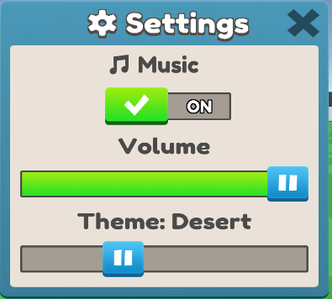
Settings
Music toggle turns music on and off
Volume slider changes music volume
Theme slider changes variable in static class that will be used to change how world is generated
X button closes settings pop up
Notes:
World generation at the time of this slide can only generate forest and desert.

Slide 8
Save System
New values being tracked
Resources
Aesthetic preferences
User settings
Wave number
etc

Slide 9
Game Tweaks
Broke a few things to implement the new UI system
Overall broken state but just needs “rewiring” to change to new system
In the process of adding visual health indicators for enemies
Possible going to rewrite how spawning enemies work to better implement the wave system

Slide 10
QA Testing
● WEBSITE FUNCTIONALITY
Mobile testing
As of 3/15, IOS and Android now have a functional website with appropriate navbar.
Unity demo functional across all browsers.
As of 3/15, login/logout work properly.
As of 3/15, New button on top right corner of the page successfully redirects user to their own user profile pages
User Account Creation
As of 3/15, users are now able to confirm their password before officially creating the account. Issue from sprint 4 is resolved.
Email verification with link and security code still fully functional on desktop web browsers. Tested on chrome, firefox, safari and edge and mobile Safari.
Email verification works properly on Gmail accounts.
There is now an option to show that the user is logged in. However, it would be nice to click the username on the top right-hand corner which presents a drop-down menu showing to logout.
As of 3/15, logging in redirects users to the game. This is resolved from sprint 4.
Successful account creation message still appears properly.
As of 3/15, receiving verification email to an iCloud email account sends a invalid link. Testing with Gmail email address works properly. This is because on emails other than Gmail, there is no period before .org, resulting in an invalid link.

Slide 11
QA Testing
Leaderboard Functionality
New implementation of personalized scores are on all user profile pages now.
Terminology of the leaderboard page needs to be tweaked.
Need to consider hiding real names of the players and only use the alias, or consider it an “opt in” feature.
UI/UX functionality
Gear icon implemented in the UI which brings up the paused menu, working as intended.
Resource management bar is being updated as intended using intended resources on every newly generated map.
New UI graphics have been implemented across the board and is working as intended.
Clicking “new game” starts a scene and a sound plays. This is working as intended.

Slide 12
Goals for Sprint 6
Load terrain from save (harder)
Access settings from game scene (easier)
More than one tower type
Moving game into website
Documentation updating
Intensive QA

Slide 13
Demo

